Slide 1
Logical Database Design
Adapted from Chapter 17 (Connolly & Begg)

Slide 2
Logical database design
Logical data model process: represent a conceptual data model using a specific data model.
We will be using the relational data model, so we will be representing the conceptual data as relations.

Slide 3
Steps to the logical database design
Derive relations for logical data model
Validate relations using normalization
Validate relations against user transactions
Check integrity constraints
Review logical data model with user

Slide 4
Derive relations for ...
Strong entity types
Weak entity types
1 to many (1:*) binary relationship types
1 to 1 (1:1) binary relationship types
1 to 1 (1:1) recursive relationship types
Superclass /subclass relationship types
Many to Many (*:*) binary relationship types
Complex relationship types
Multi-values attributes

Slide 5
Maps to a relation
Strong entity | Create a relation that contains all simple attributes
Weak entity | Create a relation that contains all simple attributes - primary key must take into account the owner entity’s key
*:* binary relationship | Create a relation for the relationship, including all relationship attributes. Each entity in the relation is a foreign key in the relationship’s relation.
1:1 binary relationship Mandatory participation Optional participation Both entities optional | Combine entities into 1 relation Define a foreign key for relation associated with mandatory participation Your choice for representation (either can have FK)
Multi-valued attributes | Define a relation for the multi-valued attribute and create a foreign key to the relation representing the containing entity
Complex relationship | Create a relation for the relationship, including all relationship attributes. Each entity in the relation is a foreign key in the relationship’s relation.

Slide 6
Maps to a foreign key
Entity/Relationship | Mapping to logical design
1:* binary relationship | Define a foreign key on the “many” side. It points to a candidate key on the “1” side”. All relationship attributes are stored in the “many” relationship. No relation necessary for relationship.
*:* binary relationship | Create a relation for the relationship, including all relationship attributes. Each entity in the relation is a foreign key in the relationship’s relation.
1:1 binary relationship Optional participation Both entities optional | Define a foreign key for relation associated with mandatory participation Your choice for representation (either can have FK)
Multi-valued attributes | Define a relation for the multi-valued attribute and create a foreign key to the relation representing the containing entity

Slide 7
Superclass/Subclass conversion
Participation | Disjoint constraint | Mapping to logical design
Mandatory | Nondisjoint (AND) | Single relation with 1 or more attributes acting as a discriminator for the subclasses
Mandatory | Disjoint (OR) | Many relations one for each subclass/superclass combination
Optional | Nondisjoint (AND) | Two relations, 1 relation for the superclass and 1 relation for all of the subclasses, subclass needs a discriminating attribute to differentiate type of subclass
Optional | Disjoint (OR) | Many relations, one relation for the superclass, one relation for each subclass

Slide 8
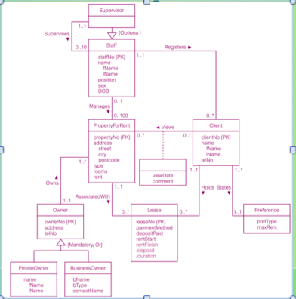
Classwork: create relations for the following conceptual model

Slide 9
Normalization to be covered later
In a separate presentation.

Slide 10
Check integrity constraints
Types of integrity constraints
Identifying attributes that are required
For each column decide if it needs to have a value
Attribute domain constraints
List or describe the legal values for each attribute
Multiplicity
Ensure the relationship constraints are properly represented
Entity integrity
Primary key attributes cannot hold a NULL value
Referential integrity
Foreign key created in the child tuple linking to existing parent tuple
General constraints

Slide 11
Referential integrity defines DB behavior
Define the desired database behavior to ensure that a child relation NEVER references a parent relation instance that does not exist.
Review changes to the child relation.
CREATE a new record in the child relation
If all foreign key attributes are NULL no check.
If not NULL ensure parent tuple exists
UPDATE a foreign key attribute in the child relation
Same as above
DELETE a record from the child relation
Operation cannot violate referential integrity.

Slide 12
Referential integrity defines DB behavior
Review changes to the parent relation.
UPDATE a primary key attribute in the relation
Identify the child tuples in the other table referencing this instance
May choose to not allow update (ON UPDATE RESTRICT)
May choose to allow UPDATE to parent relation to propagate to child (ON UPDATE CASCADE)
May choose to remove the link between the 2 entities (ON UPDATE SET NULL or ON UPDATE SET DEFAULT)
DELETE a record from the parent relation
Same as above except DELETE as oppose to UPDATE
CREATE a record in the parent relation
No check to be done

Slide 13
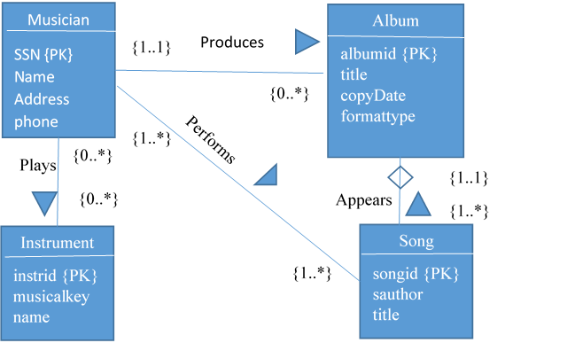
Classwork: convert to a logical db design

